Slide 1


Compute eigenvectors and eigenvalues using the QR algorithm
Bar Shimon Malka 313393324
Guy shlomo banbo 316139310
Amit Benita 315949594

Slide 2
QR Algorithm with Wilkinson Shifts
Algorithm Steps:
1. Convert the input matrix to Hessenberg form
2. Iterative QR factorization of the shifted matrix for calculating the eigenvectors :
2.1 . Calculating the wilkinson shift as u
2.2 . Perform HouseHolder QR to the shifted matrix (A- u*I)
2.3 . Update Matrix: Compute the new matrix A as RQ+ul
2.4. Multiply the eigenvector matrix by Q
Return to step 2.1 until the smallest upper-diagonal element is larger than (epsilon)
3. Divide the matrix into upper and lower blocks , Recursively compute eigenvalues and eigenvectors for each block
4. Merge the results from these two blocks
5.Return the eigenvalues and the transformed eigenvector matrix (for n=1 just return a[0,0] and I)

Slide 3
Python advantages and disadvantages
Python disadvantages :
uses a lot of memory in the recursion of the QR algorithm
Hard to detect errors
The numpy library doesn’t have matrix and vector types- they are both
Represented by arrays, which can lead to some mistakes
Python advantages :
More suitable for working with mutable objects
Have rich libraries like numpy

Slide 4
Haskell advantages and disadvantages
Haskell disadvantages :
1.Working with mutable matrixes in the house holder function required making immutable copy's of the matrix to use Hmatrix build operation
2. the laziness of the language made us reduce the number calculations and to use more optimization than python in order to get the good performance.
3.Suffer from less documentations and examples
Haskell advantages:
The laziness of the language causes our Haskell code to use less RAM than python
The Haskell compiler helped detect some errors before running the code
Contains both matrix and vector types in the Hmatrix library, which helped avoid some mistakes
When doing an operation that involve both types like matrix-vector multiplication.

Slide 5
Optimization Techniques
In both languages:
Hessenberg
Wilkinson shift
householder
Recursive decomposition
Haskell optimization:
-reducing the number of calculations in the updating of q and r in the householder function Using Hmatrix matrix and vectors operations- made the code faster by 7
-use mutable matrices and in-place updates as needed to reduce the runtime
Python optimization:
-numpy Vectorized mask operations in hessenberg- creates a boolean mask and applies a conditional operation to a subset of matrix elements

Slide 6

python

Slide 7
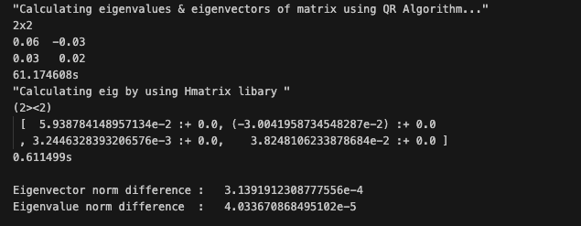
Haskell

